Slide 1
US Airline sentiment analysis using Twitter data
Yaya Liu
Fall 2019

Slide 2
Agenda
Background and project objectives
Data
Data description and visualizations
Data related risks
Data balancing
Data pre-processing
Multi-classification model evaluation
Machine learning models
Findings and feature work

Slide 3
Background
As of 2019, 3.5 billion people actively using social platforms. 500 million Tweets are tweeted every day. People share their genuine emotions, feelings, opinions and experiences on social media.
More and more companies start utilizing online data to improve customer service, enhance business competitiveness, perform crisis management. One of the popular text analysis techniques is sentiment analysis.
Sentiment analysis started in early 2000s. Multiple approaches have been developed and a lot of research has been done in various fields afterwards. But only a few studies directly focused on the area of airlines based on Twitter data
Notes:
Source: https://www.geekwire.com/2013/qa-instacart-ceo-apoorva/

Slide 4
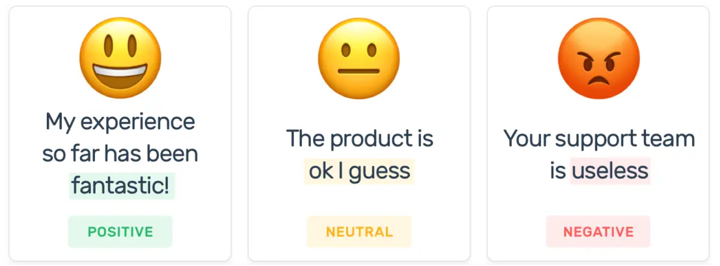
Project objectives
The main goals of this project are to perform sentiment analysis in the area of US airline service using Twitter data and explore techniques that are related to sentiment analysis.
Sentiment analysis: inspecting the given Tweet and determining a user’s attitude as positive, negative, or neutral.

Slide 5
Data

Slide 6
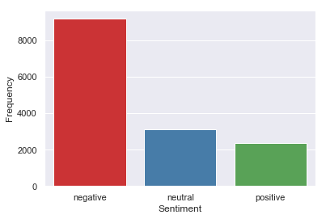
Data Source & Description
Data is from Kaggle.
Data includes 14, 640 Tweets covering six U.S. airline companies: American,
Delta, Southwest, United, US Airways, Virgin America.
Each Tweet has already been labeled as “negative”, “neutral” or “positive” class.
Class distribution is skewed towards negative Tweets.
Negative: 9, 178
Neutral: 3, 099
Positive: 2, 363

Slide 7
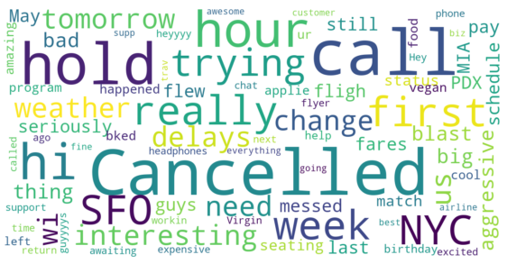
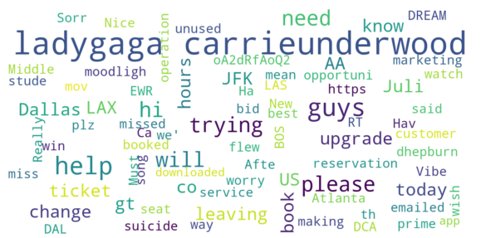
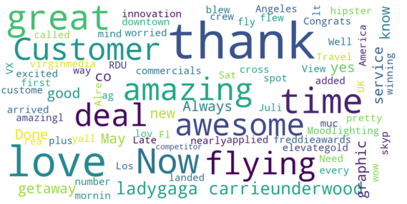
Data Visualization
Negative Tweets
Neutral Tweets
Positive Tweets

Slide 8
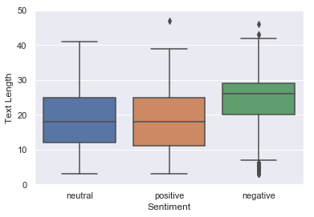
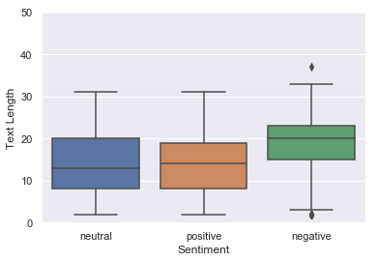
Data Visualization
Number of words and punctuations in each class
(before text pre-processing)
Number of words in each class
(after text pre-processing)

Slide 9
Data related risks
The service-related data from Twitter is often imbalanced. There are more negative Tweets than neutral and positive Tweets.
Most of the Tweets are very short. They may not include enough context to identify the users’ attitudes.
Tweets have a lot of “noise” comparing to published articles, such as emojis, external links, user mention, hashtags, etc. But since most of the Tweets are very short, do we need to remove all of them?

Slide 10
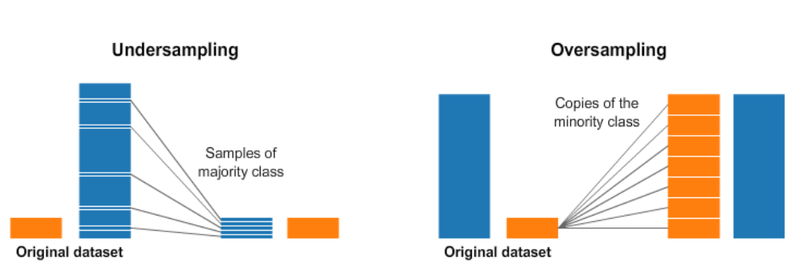
Data Balancing
under-sampling: removing samples from the majority class.
over-sampling: adding more examples from the minority class.
risk: information loss risk: overfitting
Referenced from https://www.kaggle.com/rafjaa/resampling-strategies-for-imbalanced-datasets

Slide 11
Data pre-processing
Decapitalized all characters to reduce the number of word types.
Removed special characters, emojis, numeric digits, web links and punctuations.
Lemmatization with WordNet lexical database based on POS tags.
-> replace a word with its base form, which is known as lemma.
Why not stemming?
 | really missed a prime opportunity for men without hats parody
Lemmatization | really miss a prime opportunity for men without hat parody
stemming | realli miss a prime opportun for men without hat parodi

Slide 12
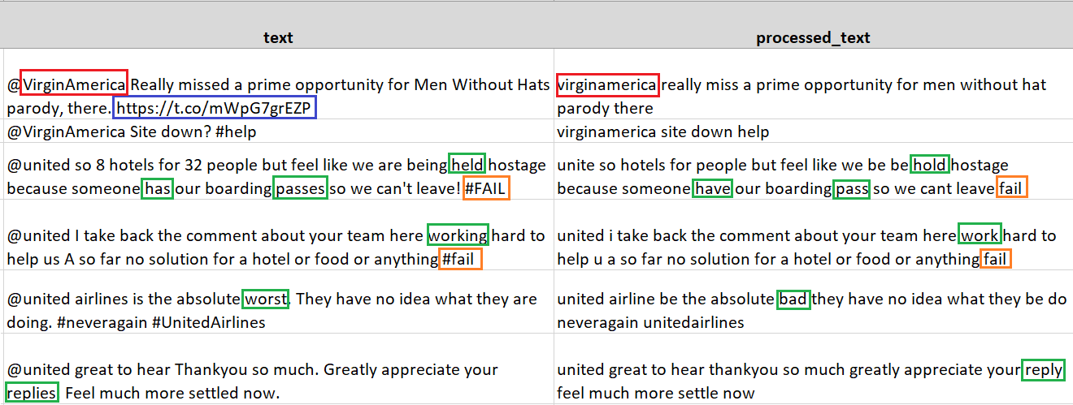
Data pre-processing

Slide 13
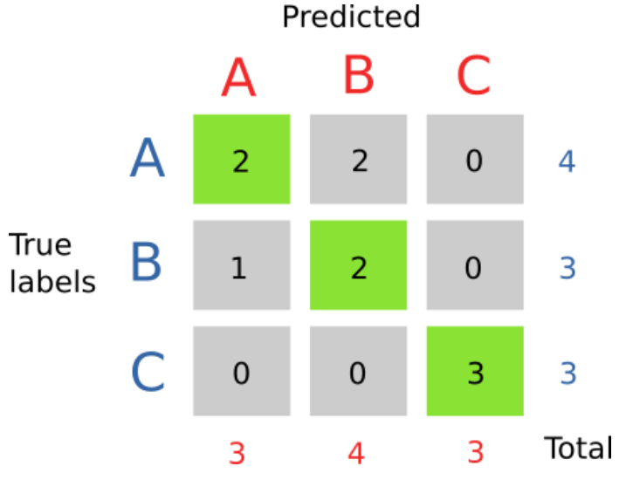





Multi-classification model evaluation
How to measure model’s performance?
Accuracy = Number of correct predictions / Total number of instances
Macro F1-score
= Average of
Weighted F1-score

Slide 14
Machine learning models

Slide 15
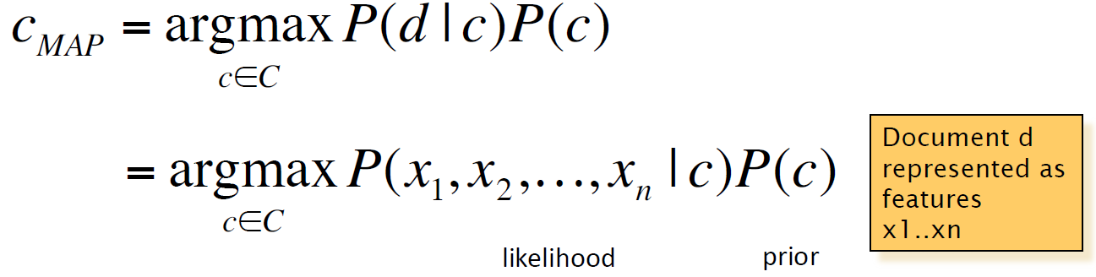
Naïve Bayes
Naïve Bayes model finds the probabilities of classes assigned to texts by using the prior probability of the class and the likelihood, which is the probability of the text based on the class.
In order to calculate the likelihood, Naïve Bayesian model treats each Tweet as a bag-of-words, and it assumes the position of the words doesn’t matter and the features’ probabilities are independent with each other given the class.

Slide 16
Naïve Bayes
TF-IDF + Bag-of-words
 | Precision (Macro Average) | Recall (Macro Average) | F1 Score (Macro Average) | Accuracy (Overall)
Original data | 0.80 | 0.41 | 0.41 | 0.67
Oversampling data | 0.71 | 0.71 | 0.71 | 0.78
Undersampling data | 0.71 | 0.72 | 0.71 | 0.78
TF-IDF + Combination of Bag-of-words, bigrams and trigrams
 | Precision (Macro Average) | Recall (Macro Average) | F1 Score (Macro Average) | Accuracy (Overall)
Original data | 0.76 | 0.39 | 0.36 | 0.65
Oversampling data | 0.74 | 0.74 | 0.74 | 0.79
Undersampling data | 0.72 | 0.71 | 0.71 | 0.78

Slide 17
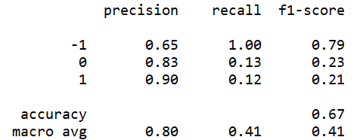
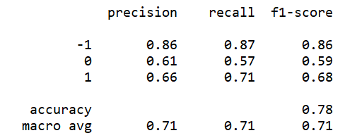
Naïve Bayes
Why the model has low recall and F1 Score when original data is used?
Predicted
Predicted
-1 0 1 All
-1 0 1 All
1811 | 5 | 1 | 1817
541 | 82 | 5 | 628
415 | 12 | 56 | 483
2767 | 99 | 62 | 2928
-1
1574 | 162 | 81 | 1817
177 | 357 | 94 | 628
77 | 65 | 341 | 483
1828 | 584 | 516 | 2928
-1
True
True
0
0
1
1
All
All
Original data with TF-IDF + Bag-of-words
Oversampling data with TF-IDF + Bag-of-words

Slide 18
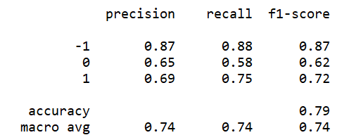
Naïve Bayes
Why over-sampling data with N-gram (Bag-of-words, bigrams and trigrams) outperforms oversampling data with bag-of-words?
Predicted
Predicted
-1 0 1 All
-1 0 1 All
-1
1574 | 162 | 81 | 1817
177 | 357 | 94 | 628
77 | 65 | 341 | 483
1828 | 584 | 516 | 2928
-1
1594 | 144 | 79 | 1817
179 | 367 | 82 | 628
65 | 54 | 364 | 483
1838 | 565 | 525 | 2928
True
True
0
0
1
1
All
All
Over-sampling data with TF-IDF + Bag-of-words
Over-sampling data with TF-IDF + N-gram

Slide 19
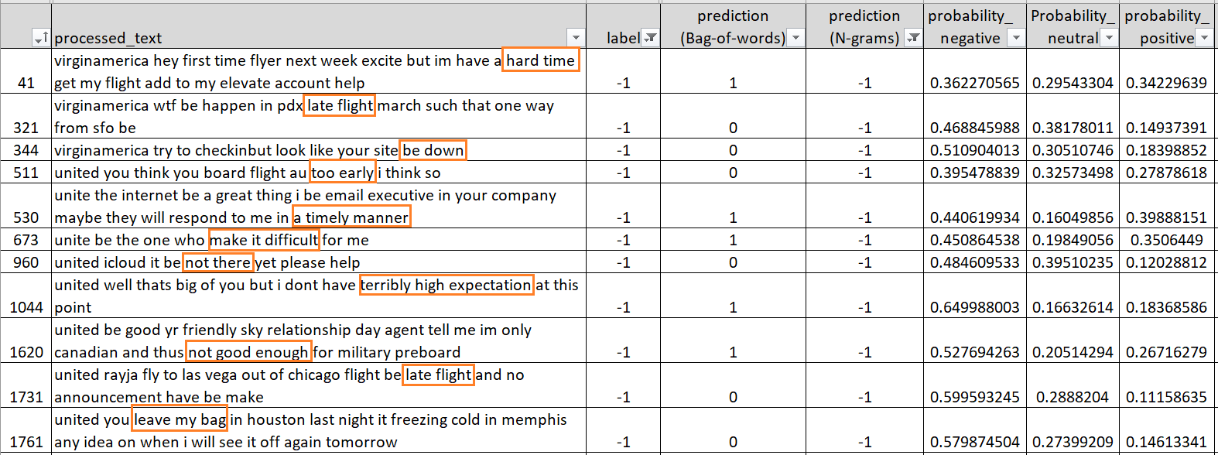
Naïve Bayes
Why over-sampling data with N-gram (Bag-of-words, bigrams and trigrams) outperforms oversampling data with bag-of-words?

Slide 20
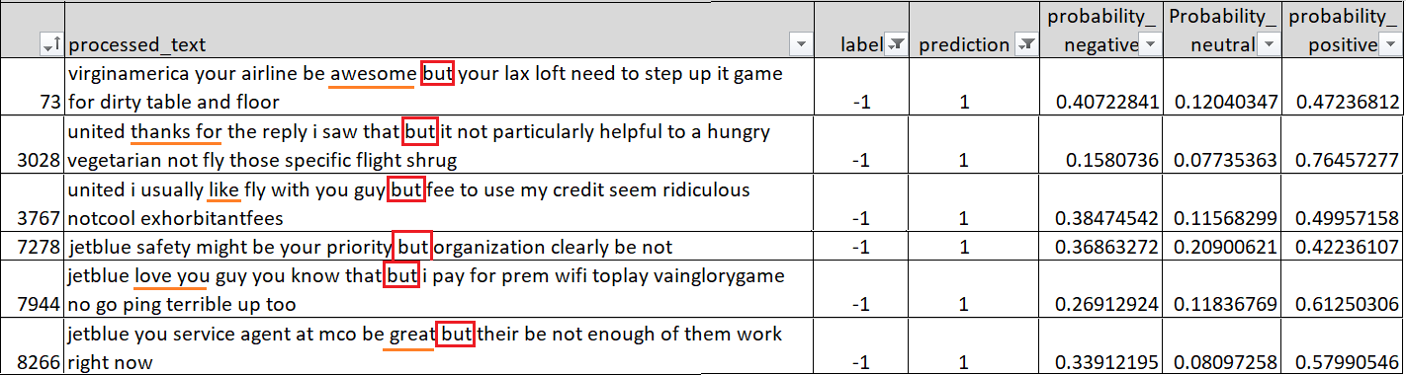
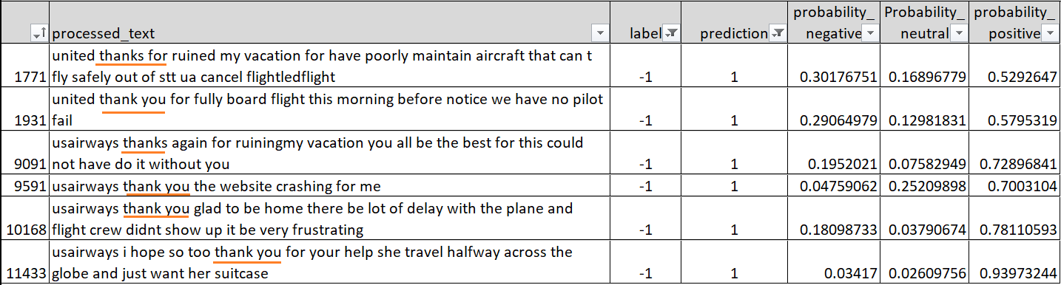
Naïve Bayes
Error analysis based on NB + over-sampling + N-gram

Slide 21
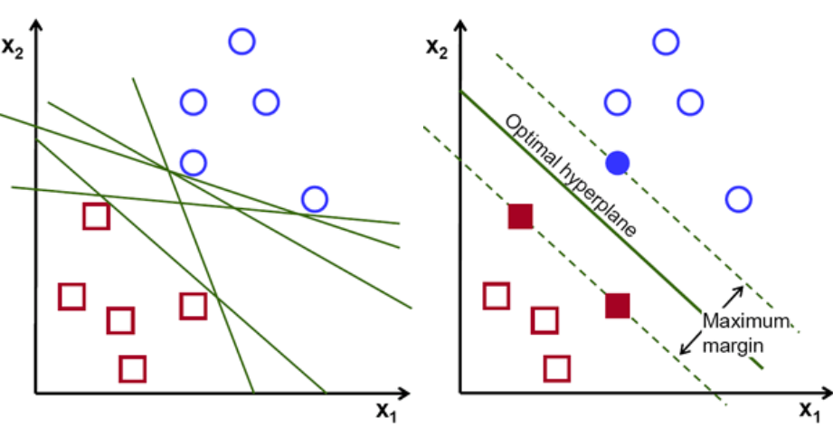
Support Vector Machine (SVM)
SVM finds the hyperplane that maximizes the margin as well as minimizes the probability of misclassification.
The instances on the edge of the margin are called support vectors, and the decision boundary is fully determined by the support vectors.
Referenced from https://towardsdatascience.com/svm-feature-selection-and-kernels-840781cc1a6c

Slide 22
Support Vector Machine (SVM) / TF-IDF
TF-IDF + Bag-of-words
 | Precision (Macro Average) | Recall (Macro Average) | F1 Score (Macro Average) | Accuracy (Overall)
Original data | 0.77 | 0.70 | 0.73 | 0.80
Oversampling data | 0.72 | 0.73 | 0.72 | 0.77
Undersampling data | 0.69 | 0.73 | 0.70 | 0.75
TF-IDF + Combination of Bag-of-words, bigrams and trigrams
 | Precision (Macro Average) | Recall (Macro Average) | F1 Score (Macro Average) | Accuracy (Overall)
Original data | 0.79 | 0.70 | 0.73 | 0.80
Oversampling data | 0.76 | 0.73 | 0.74 | 0.80
Undersampling data | 0.71 | 0.73 | 0.72 | 0.78

Slide 23
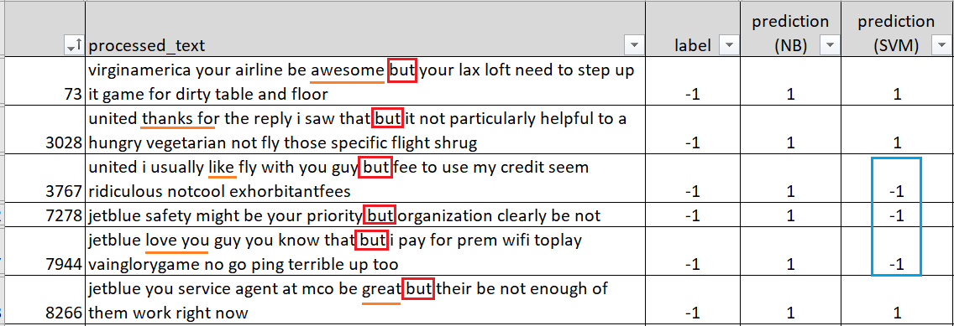
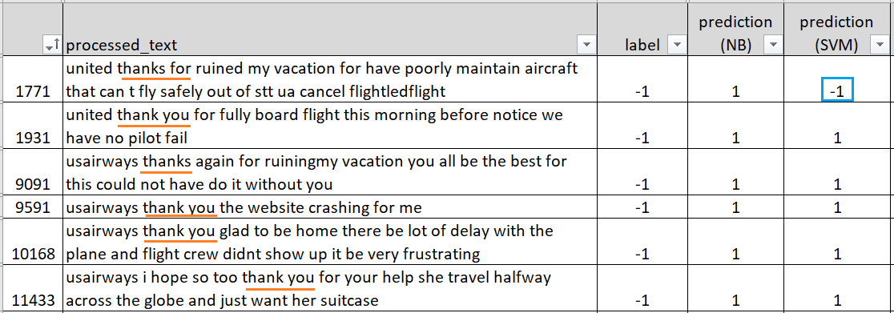
Support Vector Machine (SVM) / IF-IDF
Error analysis based on SVM + over-sampling data + N-gram

Slide 24
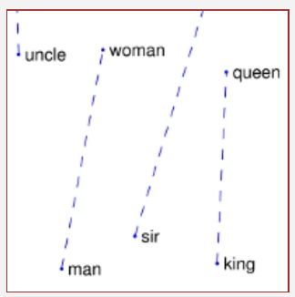

GloVe (global vectors for word representation)
GloVe is an unsupervised machine learning algorithm for getting vector representations for words.
The GloVe model is trained on a global word-word co-occurrence matrix, which records how frequently words co-occur with one another in a given corpus.
If two words are co-exist many times, both words may have similar meaning, such as man and woman. GloVe uses a linear structure to capture the difference of frequently co-exist words.
Referenced from https://nlp.stanford.edu/projects/glove/

Slide 25
Support Vector Machine (SVM) / GloVe
Over-sampling and under-sampling improve the recall.
Results are much worse than Naïve Bayes and SVM with bag-of-words and
N-gram.
 | Precision (Macro Average) | Recall (Macro Average) | F1 Score (Macro Average) | Accuracy (Overall)
Original dataset | 0.72 | 0.63 | 0.66 | 0.76
Oversampling data | 0.65 | 0.68 | 0.66 | 0.71
Undersampling data | 0.66 | 0.69 | 0.67 | 0.72

Slide 26
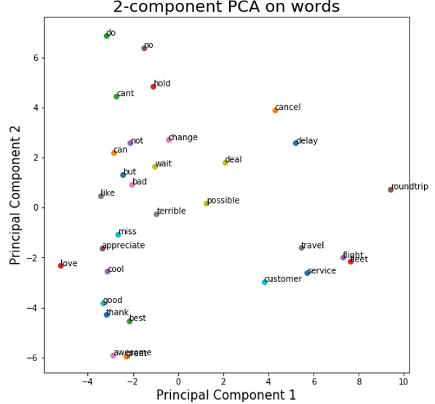
Support Vector Machine (SVM) / GloVe
Why SVM with GloVe is worse than SVM with TF-IDF and bag-of-words/N-gram?
Pre-trained GloVe word vectors are from Stanford https://nlp.stanford.edu/projects/glove/
Word vectors are trained on 2B tweets, 27B tokens, 1.2M vocabularies.
A 100-dimension vector is used to represent a word.

Slide 27
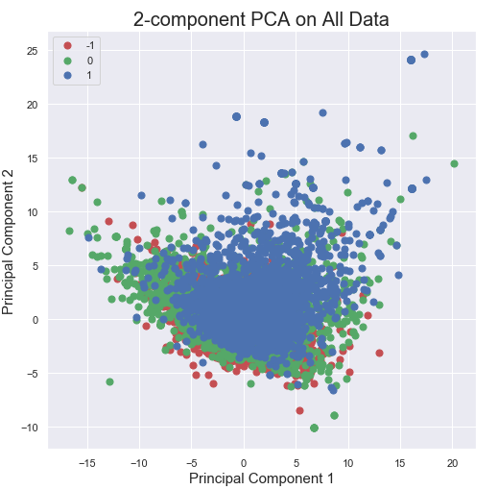
Support Vector Machine (SVM) / GloVe
Why SVM with GloVe is worse than SVM with TF-IDF and bag-of-words/N-gram?
Original data: 11672 out of 249986 (4.7 %) words are not in pre-trained model.
Over-sampling data: 20492 out of 391057 (5.2 %) words are not in pre-trained model.
Under-sampling data: 6928 out of 137055 (5 %) words are not in pre-trained model.

Slide 28
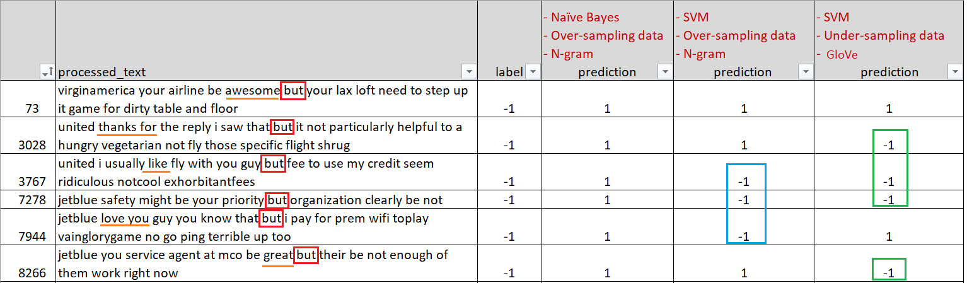
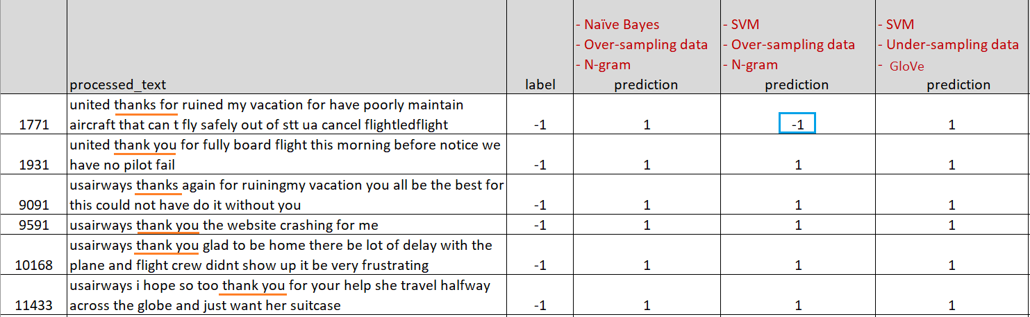
Support Vector Machine (SVM) / GloVe
Error analysis based on SVM + under-sampling + GloVe

Slide 29
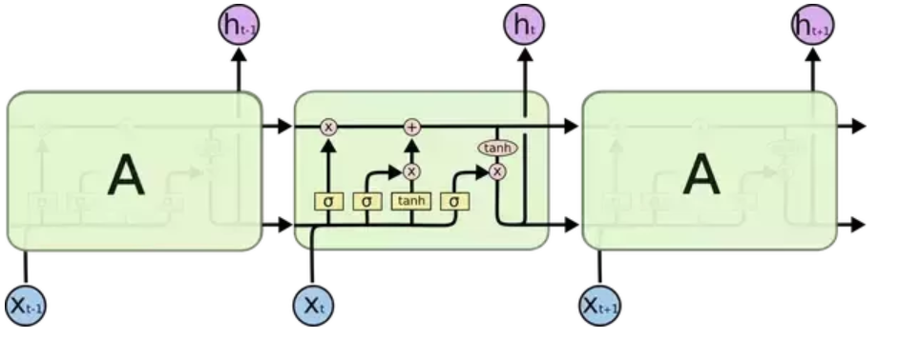
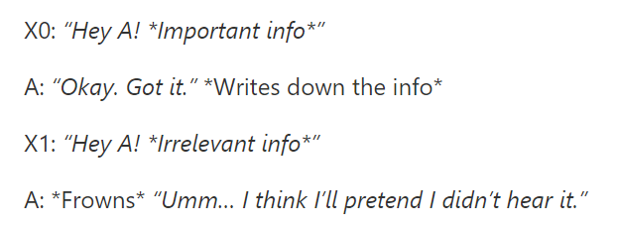
Long Short-Term Memory Networks
LSTM networks are a type of recurrent neural networks (RNNs).
LSTM networks can “remember” or “forget” information in the cell state by using specialized neurons called “gates”.
This gating mechanism fixes the “short-term memory” problem of RNNs.
Referenced from:
https://www.quora.com/How-is-LSTM-different-from-RNN-In-a-layman-explanation

Slide 30
Long Short-Term Memory Networks
Model configuration
1 embedding layer.
Size of the vocabulary: 10347
Size of word embedding vector : 16
LSTM with 8 neurons.
1 dense layer (activation: softmax).
Optimizer: adam, epochs: 8, batch size: 48.
 | Precision (Macro Average) | Recall (Macro Average) | F1 Score (Macro Average) | Accuracy (Overall)
Original data | 0.76 | 0.73 | 0.74 | 0.80

Slide 31
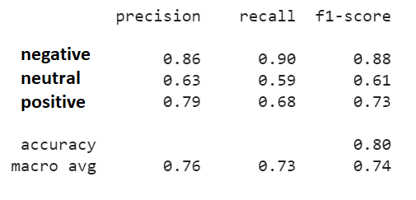
Long Short-Term Memory Networks
Predicted
negative neutral positive All
negative
1641 | 146 | 30 | 1817
197 | 371 | 60 | 628
80 | 74 | 329 | 483
1918 | 591 | 419 | 2928
True
neutral
0
positive
All
LSTM networks with original data

Slide 32
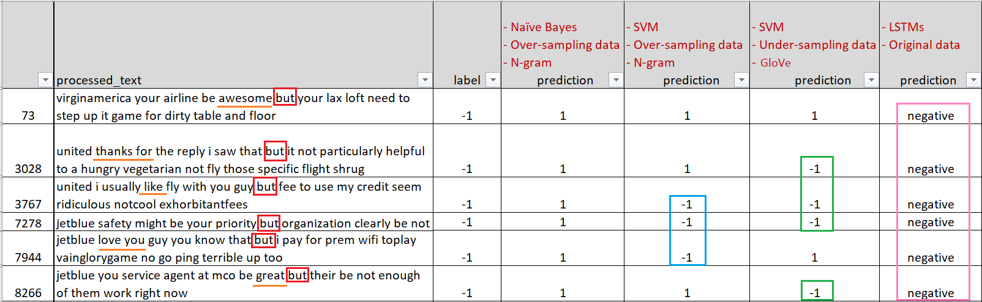
Long Short-Term Memory Networks
Error analysis based on LSTM networks with original data.

Slide 33
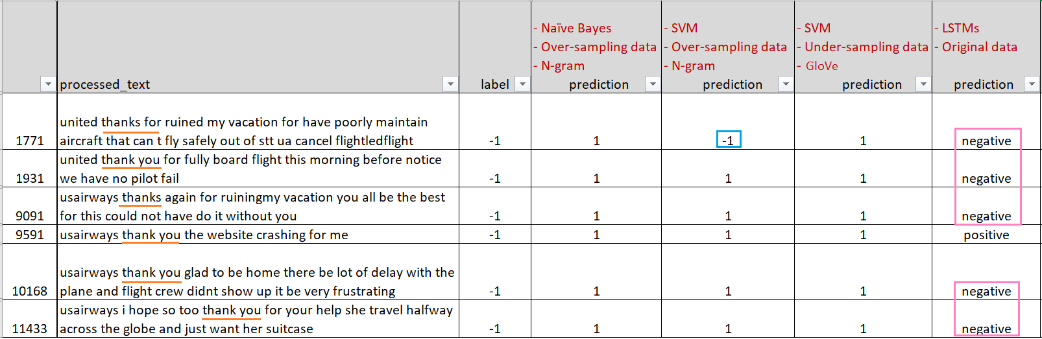
Long Short-Term Memory Networks
Error analysis based on LSTM networks with original data.

Slide 34
Results
 | Precision (Macro Average) | Recall (Macro Average) | F1 Score (Macro Average) | Accuracy (Overall)
Naïve Bayes Over-sampling data Bag-of-words TF-IDF | 0.71 | 0.71 | 0.71 | 0.78
Naïve Bayes Over-sampling data N-gram TF-IDF | 0.74 | 0.74 | 0.74 | 0.79
SVM Over-sampling data Bag-of-words TF-IDF | 0.72 | 0.73 | 0.72 | 0.77
SVM Over-sampling data N-gram TF-IDF | 0.76 | 0.73 | 0.74 | 0.80
SVM Under-sampling data GloVe pre-trained vectors | 0.66 | 0.69 | 0.67 | 0.72
LSTM networks | 0.76 | 0.73 | 0.74 | 0.80
Notes:
The key point of this method is to avoid including all the data points for training. Data points with small gradients tend to be more well trained, so it is important to focus on data points with larger gradients. LightGBM selects all the data points with large gradients as well as a random sample of the data points with small gradients in order to prevent changing the original distribution of the data.

Slide 35
Findings
Data balancing techniques can offset the Naïve Bayes and SVM models’ bias towards the majority class. Generally speaking, over-sampling has a better performance than under-sampling on short texts.
Features
Naïve Bayes and SVM models has a better performance with N-gram than bag-of-words.
There is no guarantee that GloVe will yield better results than bag-of-words or N-gram on any data.
Models
Naïve Bayes model is more sensitive to imbalanced data than SVM model. However, LSTM networks can handle imbalanced data well.
Although Naïve Bayes/SVM models with oversampling data and N-gram have similar performance with LSTM networks with original data, but LSTM networks has relatively higher recall on negative Tweets, and they give better predictions on Tweets that contain a twist and sarcasm.
LSTM networks is prone to overfitting. Therefore, it requires a lot of work on model tuning.

Slide 36
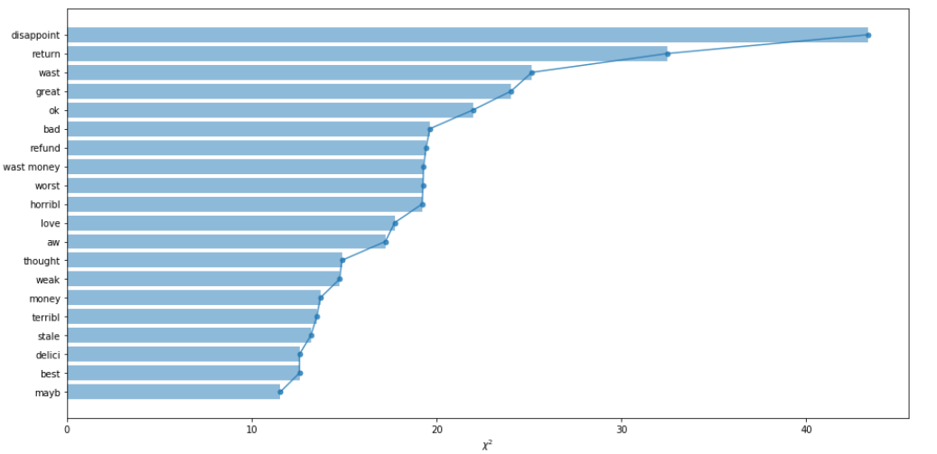
Future work
Building ensemble models
Feature selection
Referenced from https://blog.usejournal.com/sentiment-classification-with-natural-language-processing-on-lstm-4dc0497c1f19

Slide 37
Questions?

Slide 38
Backup slides

Slide 39
Related work
Wan and Gao retrieved US airline service-related Tweets. They used multiple classification models with N-gram. C4.5 Decision Tree achieved the highest F1 score: 83.6%. They managed to improve F1 score to 84.2% by combining multiple models and using majority vote to classify each Tweet.
Ankita and Anand built various classification models with Doc2vec (DM) to perform US airline sentiment analysis. Random Forest gave the highest F1 score: 86.5%.
Wan, Y., & Gao, Q. (2015, February 04). An Ensemble Sentiment Classification System of Twitter Data for Airline Services Analysis. 2015 IEEE International Conference on Data Mining Workshop (ICDMW). Atlantic City: IEEE.
Ankita, R., & Anand, K. (2018). Sentiment Classification System of Twitter Data for US Airline Service Analysis. 2018 IEEE 42nd Annual Computer Software and Applications Conference (COMPSAC). Tokyo: IEEE.

Slide 40
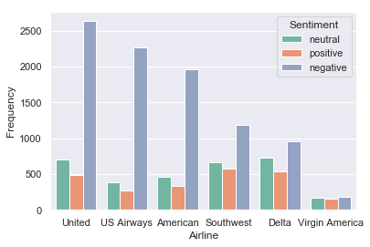
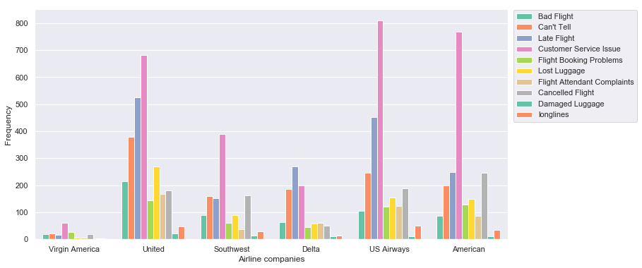
Data Visualization
Number of Tweets on each company
Reasons distribution on each company

Slide 41
Feature creation (word representation)

Slide 42
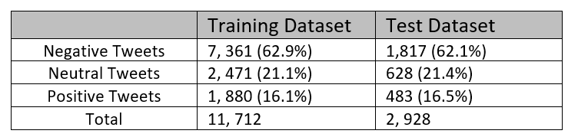
Training/Test dataset

Slide 43
Bag-of-words
Text data need to be converted numeric data for machine learning algorithm.
Bag-of-words: tokenized words are used for each Tweet and the frequency of each word is counted to represent the Tweet.
S1 = “my flight was cancelled”
S2 = “my flight plans have been delayed”
S3 = “my trip was cancelled”
Bag-of-words: [‘my’, ‘flight’, ‘was’, ‘cancelled, ‘plans’, ‘have, ‘been, ‘delayed, ‘trip’]
 | my | flight | was | cancelled | plans | have | been | delayed | trip
Vector s1 | 1 | 1 | 1 | 1 | 0 | 0 | 0 | 0 | 0
Vector s2 | 1 | 1 | 0 | 0 | 1 | 1 | 1 | 1 | 0
Vector s3 | 1 | 0 | 1 | 1 | 0 | 0 | 0 | 0 | 1

Slide 44
N-gram
N-gram is a set of co-occurring words within a given window.
Same as Bag-of-words, the frequency of each N-gram is counted and then used as features representing each Tweet.
Bigrams: [my flight, flight was, was cancelled]
S1 = “my flight was cancelled”
Trigrams: [my flight was, flight was cancelled]

Slide 45
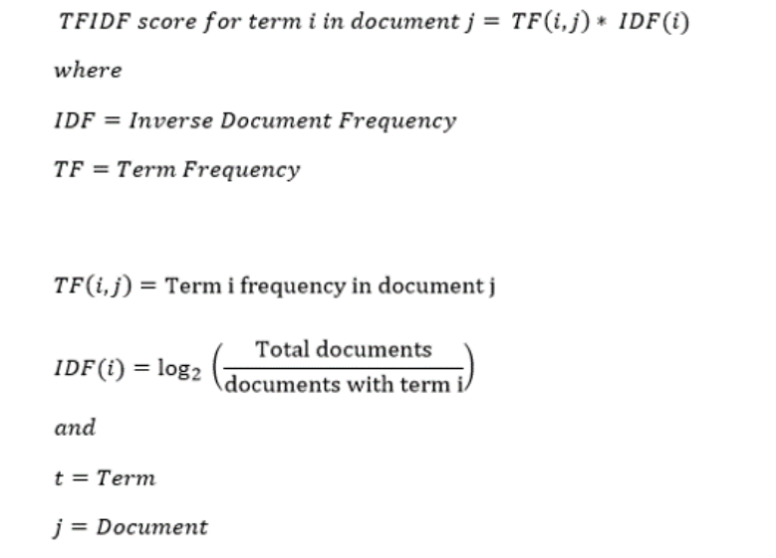
TF-IDF: Inverse Document Frequency
TF-IDF measures how important a word is to a document in a corpus.
TF-IDF works by increasing proportionally to the number of times a word appears in a document, but it is offset by the number of documents that contain the word.
Referenced from https://mungingdata.wordpress.com/2017/11/25/episode-1-using-tf-idf-to-identify-the-signal-from-the-noise/

Slide 46
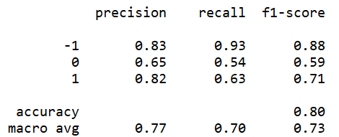
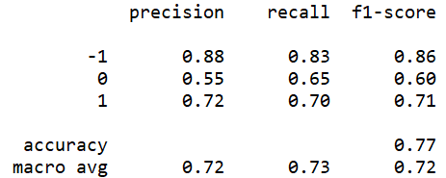
Support Vector Machine (SVM) / TF-IDF
SVM is less vulnerable to imbalanced data.
Predicted
Predicted
-1 0 1 All
-1 0 1 All
-1
1687 | 109 | 21 | 1817
241 | 341 | 46 | 628
102 | 75 | 306 | 483
2030 | 525 | 373 | 2928
-1
1509 | 253 | 55 | 1817
141 | 409 | 78 | 628
62 | 83 | 338 | 483
1712 | 745 | 471 | 2928
True
True
0
0
1
1
All
All
Original data with TF-IDF + Bag-of-words
Over-sampling data with TF-IDF + Bag-of-words

Slide 47
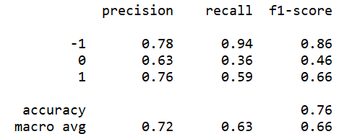
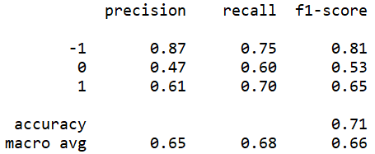
Support Vector Machine (SVM) / GloVe
Why SVM with GloVe is worse than SVM with TF-IDF and bag-of-words/N-gram?
Predicted
Predicted
-1 0 1 All
-1 0 1 All
-1
1714 | 70 | 33 | 1817
340 | 229 | 59 | 628
137 | 62 | 284 | 483
2191 | 361 | 376 | 2928
-1
1370 | 332 | 115 | 1817
148 | 377 | 103 | 628
58 | 89 | 336 | 483
1576 | 798 | 554 | 2928
True
True
0
0
1
1
All
All
Original data with GloVe
Under-sampling data with GloVe

Slide 48
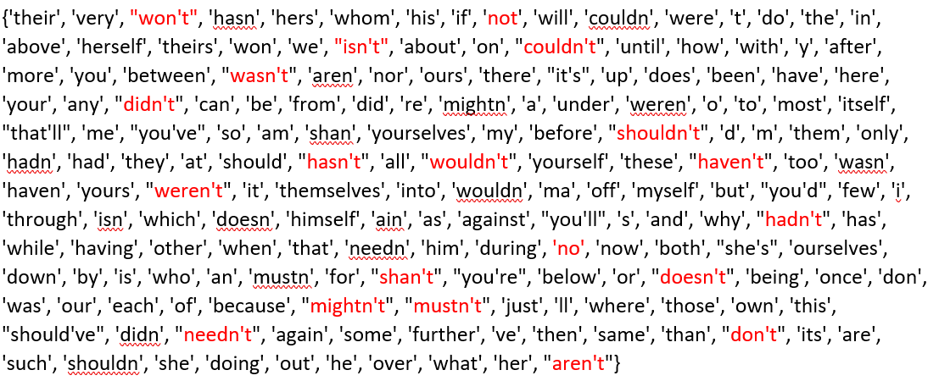
Findings
Keepings stop words (total 179 words) increases the performance of Naive Bayes and SVM TF-IDF model.
 |  | Precision | Recall | F1 Score
Naïve Bayes (Oversampling, TF-IDF) | with stop words | 0.71 | 0.71 | 0.71
 | w/o stop words | 0.69 | 0.71 | 0.70
SVM (Oversampling, TF-IDF) | with stop words | 0.72 | 0.73 | 0.72
 | w/o stop words | 0.69 | 0.71 | 0.70

